Slide 1

Shield Insurance
Shield Insurance has been helping individuals and businesses protect what matters most. Our idea is simple: make insurance easy, honest, and affordable. We offer a wide range of plans — from health and motor to home and life — all designed to give you peace of mind.

Slide 2

Objective
To provide a detailed overview of Shield Insurance's performance.
To analyze revenue trends, customer demographics, and sales modes.
To help identify key contributing factors and areas for improvement.

Slide 3
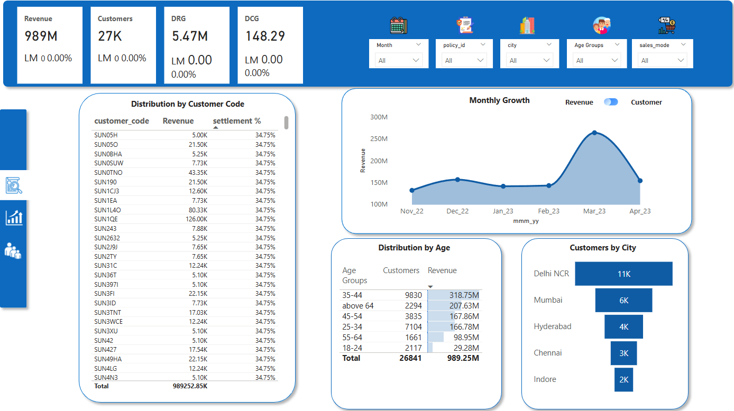
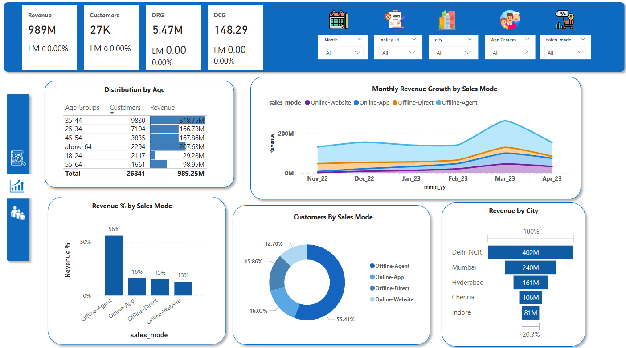
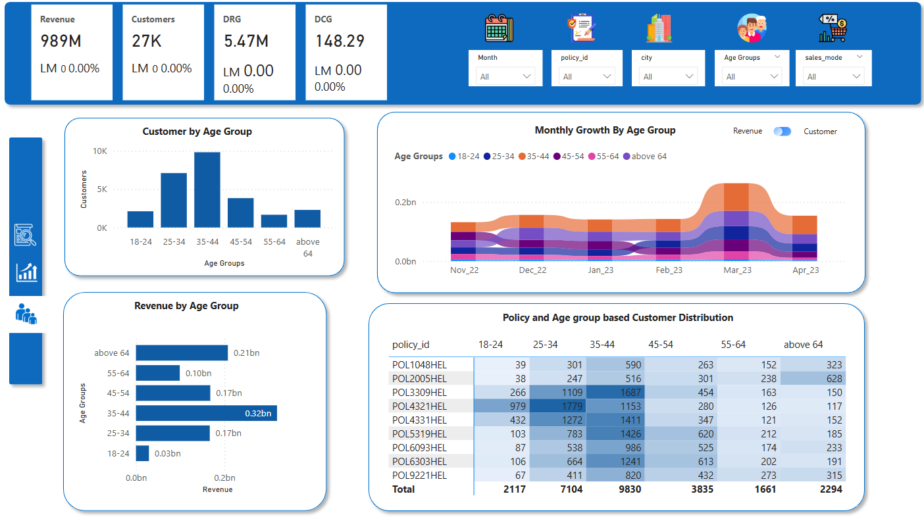
Dashboard Overview
General View
Sales View
Age Group View
This dashboard gives a high-level overview of total revenue, customer count, and growth trends. It allows filtering by month, policy, city, and age group to explore the data in more depth. The dashboard also highlights key performing customer segments and cities.
This dashboard compares revenue and customer distribution across different sales modes. It features visual comparisons and a monthly trend analysis to observe how different channels are performing over time. Regional performance is also shown for additional business insights.
This dashboard focuses on analyzing revenue and customer data by age group. It shows which age brackets are the most active and how their preferences vary by policy. Monthly trends are included to understand changes in customer behavior over time.

Slide 4
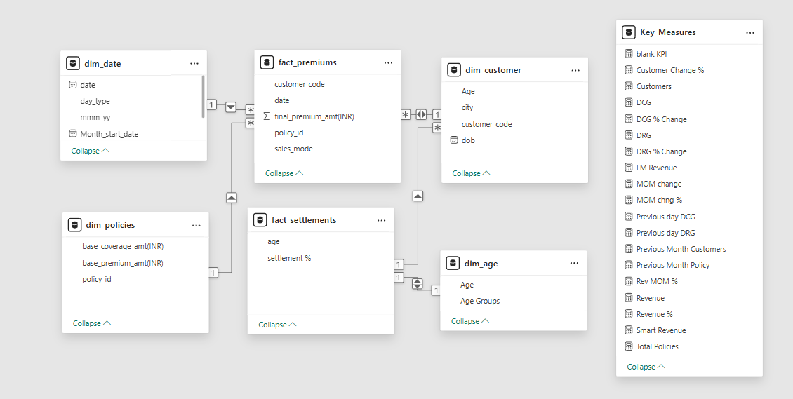
Data model View

Slide 5

Overall Business Snapshot
Revenue: ₹989M | Customers: 27K
35–44 age group is the top contributor (₹318M)
Highest customer count in Delhi NCR (11K)
March showed the best growth
Possible Reasons:
March peak could be due to renewal offers or seasonal campaigns.
Delhi NCR likely has better agent coverage or brand trust.
Suggestions:
Try similar marketing in other cities.
Repeat successful March offers in future months.

Slide 6

Possible Reasons:
Customers may prefer personal contact with agents
Digital platforms may lack awareness or trust factor
Suggestions:
Offer extra benefits for online purchases
Improve mobile app and website for ease of use
Train agents to encourage digital shift
Revenue by Sales Mode and City
Revenue share by mode:
Offline Agent: 56%
Online App: 16%
Offline Direct: 15%
Online Website: 13%
Most revenue comes from Delhi NCR (₹402M)
Possible Reasons:
Customers may prefer personal contact with agents
Digital platforms may lack awareness or trust factor
Suggestions:
Offer extra benefits for online purchases
Improve mobile app and website for ease of use
Train agents to encourage digital shift

Slide 7

Customer distribution By Age
Most customers: 35–44 (9.8K), 25–34 (7.1K)
Low in 18–24 group (2.1K), also low revenue (₹29M)
Possible Reasons:
Younger audience may not see value in insurance yet.
Lack of affordable plans for students or new earners.
Suggestions:
Introduce affordable policies for younger people.
Promote health insurance benefits for early starters.

Slide 8
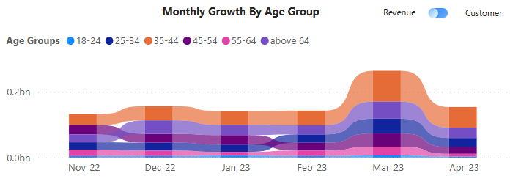
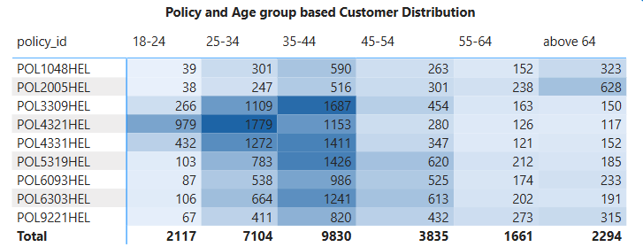
Monthly Growth by Age Group / Policy & Age Mapping
Noticeable peak in March across most age groups, especially 25–44.
March could have had a campaign or renewal drive.
Policy POL3309HEL and POL4321HEL attract large customer base across age groups.
Can focus campaigns around such policies.

Slide 9

Actionable Suggestions
Increase focus on online modes (app/website) for better digital reach.
Run targeted campaigns for younger age groups (18–24).
Study March strategies for repeatable success.
Retain strong-performing offline agent model, but gradually digitize.

